Slide 1

Accessibility for Ontarians
With Disabilities Act (AODA)
Notes:
Welcome to Scouts Canada's AODA Customer Service Training Program which was designed to review the new legislative requirements under the Accessibility of Ontarians with Disabilities Act, 2005. Ontario was the first jurisdiction in Canada to pass such legislation and is leading the way to develop, implement and enforce standards to make Ontario more accessible for everyone, especially persons with a disability.

Slide 2

Course Details
Approximately 45 minutes to complete
Time available
for questions
Notes:
This training session should run approximately 60 minutes. Through out the training we will be answering questions so please feel free to ask.

Slide 3
Learning Objectives
This course has been designed to:
Review the purposes of the AODA and the Customer Service Standard
Examine how to interact with people who have various disabilities
Instruct on what to do if a person with
a disability is having difficulty accessing programs and services
Notes:
This training course has been designed to:
- Review of the purpose of the Accessibility for Ontarians with Disabilities Act, 2005,
- Review of the requirements of the Accessibility Standards for Customer Service, Ontario Regulation 429/07.
-Provide you instructions on how to interact and communicate with people with various types of disabilities.
- Provide you instructions on how to interact with people with disabilities who: use assistive devices; require the use of a service dog or other service animal; or require a support person; and finally,
-Provide you instructions on what to do if a person with a disability is having difficulty accessing our programs and services.

Slide 4

Overview of AODA Legislation
Achieving a fully accessible
Ontario by 2025
Developing accessibility standards
Enforcing the standards
Covering both the public
and private sectors
Notes:
The purpose of the AODA includes:
• achieving a fully accessible Ontario by 2025
• developing accessibility standards
• enforcing the standards
• covering both the public and private sectors

Slide 5
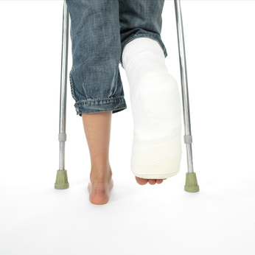
The 5 Standards
Stage One: Accessible Customer Service
Stage Two: Integrated Accessibility
  Information and Communications
  Transportation
  Employment
Stage Three: The Built Environment
Notes:
The AODA is comprised of 5 standards that will be rolled out in three stages to cover the following key areas:
Stage One is Accessible Customer Service – This standard will address and remove barriers to accessing services, programs and goods.
Stage Two is the Integrated Accessibility Standards which includes:
Information and Communication – This standard will look at information being provided in person, through print, a website and other means.
Transportation – This standard will focus on reducing the barriers to public transportation.
Employment – This standard will look at recruitment, hiring and retention.
Stage Three is the Built Environment – This standard will reduce barriers within buildings and outdoor spaces by building on Ontario's Building Code.

Slide 6

Customer Service Standard
Customer Service
Staged rollout starting with Customer Service
Notes:
The Accessibility for Ontarians with Disabilities Act was passed on June 13, 2005. This new legislation is focused on breaking down barriers and obstacles that keep people with disabilities from easily managing basic activities such as getting groceries or integrating into the workforce. The Accessibility Standards will be rolled out in stages, starting with Customer Service. The integrated standard which includes Information and Communication, Employment and Transportation can into effect on July 1, 2011 and set deadlines for the next 10 years.

Slide 7
What is a Disability?
The Human Rights Code and AODA defines disability as:
a) any degree of physical disability, infirmity, malformation or disfigurement that is caused by bodily injury, birth defect or illness and, without limiting the generality of the foregoing, includes diabetes mellitus, epilepsy, a brain injury, any degree of paralysis, amputation, lack of physical co-ordination, blindness or visual impediment, deafness or hearing impediment, muteness or speech impediment, or physical reliance on a guide dog or other animal or on a wheelchair or other remedial appliance or device,
b) a condition of mental impairment or a developmental disability,
c) a learning disability, or a dysfunction in one or more of the processes involved in understanding or using symbols or spoken language,
d) a mental disorder, or
e) an injury or disability for which benefits were claimed or 'received under the insurance plan established under the Workplace Safety and Insurance Act, 1997 ("handicap")'.
Notes:
The Human Rights Code and AODA defines disability* as:
any degree of physical disability, infirmity, malformation or disfigurement that is caused by bodily injury, birth defect or illness and, without limiting the generality of the foregoing, includes diabetes mellitus, epilepsy, a brain injury, any degree of paralysis, amputation, lack of physical co-ordination, blindness or visual impediment, deafness or hearing impediment, muteness or speech impediment, or physical reliance on a guide dog or other animal or on a wheelchair or other remedial appliance or device,
a condition of mental impairment or a developmental disability,
a learning disability, or a dysfunction in one or more of the processes involved in understanding or using symbols or spoken language,
a mental disorder, or
an injury or disability for which benefits were claimed or 'received under the insurance plan established under the Workplace Safety and Insurance Act, 1997 ("handicap")'.

Slide 8

Customer Service Standards
The AODA Customer Service Accessibility Standard requires that an employer:
create and maintain accessible customer service policies, procedures and practices
provide staff/volunteer training
create a feedback method
arrange for alternate
communication methods
provide appropriate notice
of service disruptions
Notes:
The AODA Customer Service Accessibility Standard requires that an employer:
- create and maintain accessible Customer Service policies, procedures and practices
- provide staff training
- create a feedback method
- arrange for alternate communication methods
- provide appropriate notice of service disruptions

Slide 9
Accessible Customer Service
respecting their dignity and independence
ensuring an opportunity equal to that given to other customers to obtain and use goods and services
allowing persons with disabilities to benefit from the same services, in the same place, and in a similar way to other customers
Notes:
Accessible Customer Service, under AODA, means creating a positive customer service atmosphere for people with disabilities by:
• respecting their dignity and independence
• ensuring an opportunity equal to that given to other customers to obtain and use goods and services
• and allowing persons with disabilities to benefit from the same services, in the same place, and in a similar way to other customers

Slide 10
Defining Customers
Customers can come in many different forms
Term for customer can vary between organizations
Dealing with the public and acting on behalf of the company
Notes:
Typically when we think of the word "Customers" we immediately consider it a person wishing to purchase goods or services from another person or business. However, customers can come in many different forms and could be considered: guests of the establishment, members of a club or group, participants in a program, vendors of a company, students of a school and/or clients of a business.
Customers could be colleagues asking for assistance, volunteers working within the organization, partners, children and other relatives stopping by along with individuals accessing goods and services. Depending on your organization, the term for customer could be very different.

Slide 11

Principles
Dignity
Independence
Equal opportunity
Integration
Notes:
Under the Accessible Customer Service Standard, employees, volunteers and organizations must constantly and consistently apply four principles: Dignity, Independence, Integration and Equal Opportunity. These principles encompass the vision and mission (customize to fit your company mandate). These principles are considered a basic requirement and should be reflected in everything that we do.
Let’s review each principle statement in more detail.

Slide 12

Dignity
Dignity is the innate right to respect and ethical treatment.
Notes:
Every customer shall be treated with respect and will receive the same level of goods, service, and attention.

Slide 13
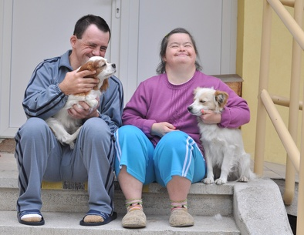
Independence
Independence is not relying on another or others for aid or support.
Notes:
Providing independence to all customers will mean that each customer is given the freedom to do things on his/her own without offering unnecessary help or interference to expedite the process.

Slide 14

Integration
Incorporating integration ensures all customers are able to access our goods and services in the same way - free from separation and barriers.
Notes:
Incorporating integration will mean that all customers are able to access our goods and services in the same way - free from separation and barriers.

Slide 15

Equal Opportunity
Equal Opportunity is the absence
of discrimination.
Notes:
Employees will ensure that each customer is provided the same opportunities. This does not necessarily mean that all customers will be given the exact same service every single time but rather that employees will recognize and adapt their approach to ensure each customer receives the same value and quality.

Slide 16

Terminology
When referring to someone
with a disability, it is extremely important that you put the person first. It is:
  a person with a disability
  a person with a physical disability
  a person with vision loss
Notes:
Based on the principles reviewed on the previous slides, it is important to use respectful terminology when referring to individuals with disabilities and when discussing types of disabilities. When referring to someone with a disability, it is extremely important that you put the person first and not address or identify him/her by the disability. For example:
Say “a person with a disability” rather than a “disabled person”
Say “a person with a physical disability” rather than a “handicapped person”
Say “a person with vision loss” rather than a “blind person”
Always show respect for the person first when addressing a person with a disability.

Slide 17
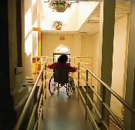
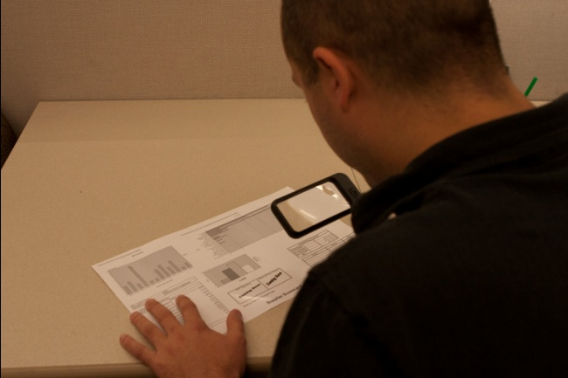
Barriers
Barriers can be:
  Physical or architectural
  Informational/communication
  Attitudinal
  Technological
  Policy or practice
Notes:
The purpose of the legislation is to remove barriers. Barriers are obstacles that make it difficult for individuals with disabilities to carry out everyday activities such as getting dressed, communicating, playing outside or enjoying time with friends and family. Barriers can be:
physical or architectural
information/communication
attitudinal
technological
policy or practice

Slide 18

Responsibilities
How can I help?
Notes:
Individuals with disabilities may have different needs. It is important to determine those needs in a way that allows all members to keep their independence and dignity intact. Don’t assume what is needed, but ask how you can help and wait patiently for the person to tell you. As an employer, this means ensuring that every one of our employees are trained and ready to assist by knowing how to handle different situations.

Slide 19
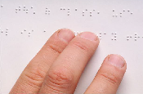

Types of Disabilities
Vision
Hearing
Physical
Intellectual
Developmental
Learning
Mental health
Speech or language
Deaf-blind
Notes:
When most people hear the word disability they think of physical disabilities such as an individual who uses a wheelchair. In fact, there are numerous other disabilities including many that are invisible or episodic. Disabilities can also vary in degree and seriousness. Regardless of the severity of the disability, the many types can be summarized in this list:
Vision
Hearing
Deaf-Blind
Physical
Speech or Language
Mental Health
Intellectual
Developmental, and/or
Learning

Slide 20

Vision Disabilities
  There are different types of vision disabilities and different levels of severity.
  Vision loss can affect a person’s ability to read or navigate and can cause trouble with depth-perception.
Notes:
There are different types of vision disabilities and different levels of severity. Vision loss reduces a person's ability to see clearly; however, very few people with vision loss are totally blind. Many have limited vision such as tunnel vision, where a person has a loss of peripheral or side vision, or a lack of central vision which means they cannot see straight ahead. Some people can see the outline of objects while others can see the direction of light.
Vision loss can affect a person’s ability to read or navigate and can cause trouble with depth-perception. Sometimes it may be difficult to tell if a person has vision loss. Individuals with vision disabilities may face barriers that include not being able to maneuver tight spaces or stairwells, requiring additional time to recognize changes to the environment and difficulties understanding pointing or motioning in a general direction.

Slide 21
Best Practice Tips: Vision Disabilities
Identify yourself
Offer assistance
Offer to read or summarize written material
Let them know if you have to leave
Offer clear and precise directions
Notes:
Best practice tips for assisting people with vision disabilities:
Identify yourself so the customer knows who is talking. Offer assistance but wait until the person accepts your offer or makes a request.
When providing written material, offer to read or summarize it.
If you need to leave the person to get something, let him/her know where you are going and when you will return.
Be clear and precise when giving directions (e.g., two steps behind you, to your right and so forth).
Before opening the door, ask if the customer wants you to open it. Indicate whether the doors open to the left or right and if it is pulled or pushed.

Slide 22

Deaf or Hard of Hearing
Similar to other disabilities, there are varying degrees of hearing loss ranging from problems in distinguishing certain frequencies, sounds or words to complete hearing loss.
Notes:
Similar to other disabilities, there are varying degrees of hearing loss ranging from missing certain words, sounds or frequencies to complete hearing loss. People who identify as “deaf” use sign language to communicate and identify as a cultural minority, rather than seeing themselves as disabled. They are bi-lingual with sign language as their native language and the spoken language as their second language. Persons who are deaf are proud of their language and culture and signal it with a capital “D”.
The major difference between people who are deaf and people who are hard of hearing is that people who are deaf use their eyes and visual sense for communicating and generally use sign language, while people who are hard of hearing still use their ears and their auditory sense. Some barriers that individuals with hearing disabilities might face include: not hearing others approaching them, not responding to alarms or other emergency situations, and not understanding speech in a noisy environment.

Slide 23
Best Practice Tips:
Deaf or Hard of Hearing
Make sure that the customer sees you
In emergency situations, assist the customer in recognizing and responding
Offer a pen and paper
Suggest moving to a quieter location
Pointing is acceptable
Notes:
Best practice tips for assisting individuals that are deaf or hard of hearing:
People who are deaf or hard of hearing may communicate in various ways such as sign language, speech, and writing. Follow the customer’s lead in communicating.
If the customer writes, respond in writing. Have a paper and pen handy. If the customer gestures, he/she wants to write.
If the customer responds by talking and lip reading, look directly at him/her and enunciate clearly in a normal tone of voice. Keep your hands or any objects away from your mouth and face. Rephrase or substitute words rather than repeat yourself again and again.
Avoid directly asking customers if they lip read as this is culturally offensive to many.
Pointing is perfectly acceptable in the deaf community. Feel free to point at or to products.
In emergency situations assist the individual in recognizing and responding to the emergency.
Persons relying on the use of a hearing aid may find it difficult to hear in a noisy environment so suggest moving to a quieter location.

Slide 24
Deaf-Blind
  Some may have some sight or hearing, while others will have neither but rely on their other senses.
  Deaf-blind interferes with communication, learning, orientation and mobility.
Notes:
Deaf-blindness is a combination of hearing and vision loss that results in a person experiencing difficulty accessing information and performing daily activities. Some persons with deaf-blindness will have some sight or hearing, while others will have neither but rely on their other senses. Deaf-blindness interferes with communication, learning, orientation and mobility. People who are deaf-blind communicate using any combination of sign language systems - Braille, telephone devices, and communication boards - and often use the services of an Intervener to relay information, facilitate auditory and visual information and act as sighted guides. The Intervener is trained to use sign language that involves touching the individual’s hand in a two-hand, manual alphabet or finger spelling.

Slide 25
Best Practice Tips: Deaf-Blind
Understand communication can take some time, please be patient
Ask what would make the customer most comfortable
Avoid sudden movements, lightly touching the hand is okay
Notes:
Some of the Customer Service tips would include:
• Understand that communication can take some time, please be patient
• Ask what would make the client the most comfortable and respect his/her needs to the maximum extent possible
• Avoid sudden movements or touching of the individual that may catch them off guard, unless it is an emergency

Slide 26

Physical Disabilities
Many physical disabilities are not visible or may even be episodic in nature.
Notes:
Physical disabilities can also come in many forms and degrees of severity. The most visible would include persons using a wheelchair or persons with amputations. However, many physical disabilities are not visible or may even be episodic in nature. For example, persons who have heart disease, asthma or lung disease may not show visible signs most of the time but occasionally suffer from their disabilities.

Slide 27
Best Practice Tips:
Physical Disability
• Ask before touching or moving any assistive device
• Talk to the customer at their eye level
• Ensure the environment is free of obstacles
Notes:
Best Practice Tips for assisting customers with physical disabilities:
• Always ask before touching or moving any assistive device;
• Ensure the environment is clear and free of obstacles;
• If you are providing one-to-one support, consider pulling up a chair and talking to the customer at their eye level.

Slide 28

Speech or Language Disabilities
Some people who have severe difficulties may use communication boards or other assistive devices.
Notes:
An individual could have speech or language impairments resulting from conditions such as cerebral palsy, hearing loss, or other conditions that make it difficult to clearly pronounce words or communicate with written or spoken language. They also may prevent the person from expressing themselves or prevent them from understanding written or spoken language. Some people who have severe difficulties may use communication boards or other assistive devices.

Slide 29
Best Practice Tips:
Speech or Language Disabilities
If you don’t understand, ask the customer to
repeat the information
Ask closed-ended questions inviting a “yes” or
“no” response
Be understanding and reassuring
Notes:
Best Practice Tips for assisting customer with speech or language impairments:
• If you don’t understand, it is okay to ask the customer to repeat the information;
• Consider asking closed-ended questions inviting a “yes” or “no” response;
• Be understanding and reassuring.

Slide 30

Mental Health Disabilities
Anxiety
Depression
Anger
Fear
Hearing Voices
Seeing Things
Memory Loss
Confusion
Notes:
Often times, you will not be aware that you are dealing with a person who has a mental health disability and it will not affect the way you provide your products or services. However, you may encounter an individual who is in crisis or is struggling and you need to know how to assist. Examples of mental health disabilities include schizophrenia, depression, phobias, as well as bipolar, anxiety and mood disorders.

Slide 31
Best Practice Tips:
Mental Health Disabilities
Listening skills are important with such situations
Ask how you can help and try to work with the customer to find a solution
Be confident, patient and reassuring
Notes:
Best Practice Tips for assisting customers with mental health disabilities:
• Listening skills are important when dealing with such situations as you need to understand the real issue to know how you can offer help.
• Ask how you can help and try to work with the customer to find a solution.
• Be confident, patient and reassuring.

Slide 32
Intellectual/ Developmental Disabilities
A person with an intellectual disorder may have trouble:
Understanding spoken and written information
Conceptualizing information
Perceiving sensory information
Remembering
Notes:
People with intellectual or developmental disabilities may have difficulty doing many things most of us take for granted. These disabilities can mildly or profoundly limit the person’s ability to learn, communicate, socialize and take care of their everyday needs. You may not know that someone has this type of disability unless you are told.
As much as possible, treat the person with an intellectual or developmental disability like anyone else. They may understand more than you think, and they will appreciate that you treat them with respect.

Slide 33
Best Practice Tips:
Intellectual Disabilities
Provide examples when sharing
and providing information
Remember that the customer,
can make her own decisions
Be patient and verify understanding
Provide information in smaller chunks
Notes:
Best Practice tips for assisting customers with intellectual disabilities:
• Provide examples when sharing and providing information
• Remember that the customer, can make her own decisions
• Be patient and verify understanding
• Provide information in smaller chunks

Slide 34

Talking to People with Disabilities over the Phone
Good service should apply to all individuals whether in person or over the phone.
Notes:
Service can take many forms - it can be in person, over the telephone, through the internet or even at a person's home. Depending on the method of delivery, service may have to be adjusted and altered to address an individual's specific type of disability. When speaking with people by phone, you do not have the opportunity to visibly identify persons with disabilities although some types of disabilities may be apparent. Good service should apply to all individuals whether in person or over the phone.

Slide 35

Best Practice Tips: Phone Interactions
Speak normally, don’t shout, and listen carefully
Avoid interrupting the customer or trying to finish his/her sentences
Politely ask the customer to repeat if you do not understand
Notes:
Best Practice tips would include:
• Speak normally, don’t shout, and listen carefully.
• Avoid interrupting or interjecting to finish sentences. Patiently wait while the person explains themselves.
• It is okay to politely ask the person to repeat information, if you do not understand.
• When using a TTY phone or message relay service, remember to speak as you would normally addressing the person and not the operator

Slide 36

Customer Service Principles
If something isn't working, ask what you can do
Notes:
Knowing what to say and how to act is the key to providing service under the core principles of dignity, independence, integration and equal opportunity. Increased service will allow individuals with disabilities to fully integrate into society as everyone will be treated fairly and equally.
Let’s review a few common scenarios.

Slide 37
When a customer arrives with a support person, it is best practice to speak directly to the support person in order to offer assistance?
Scenario #1
TRUE
FALSE
Notes:
When a customer arrives with a support person, it is best practice to speak directly to the support person in order to assist the customer?
False. You should always direct your conversation to the customer and not the support person. Acknowledge the support person, but speak directly to the customer.

Slide 38
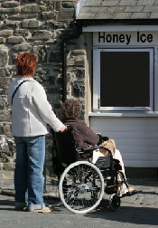
Scenario #1 - Answer
False.
Always direct your conversation to the customer and not the support person.
Notes:
When a customer arrives with a support person, it is best practice to speak directly to the support person in order to assist the customer?
False. You should always direct your conversation to the customer and not the support person. Acknowledge the support person, but speak directly to the customer.

Slide 39
If a customer arrives with a white cane or guide dog, I should go and get the product for them?
Scenario #2
TRUE
FALSE
Notes:
If a customer arrives with a walking stick or guide dog, I should offer to go and get the product for them.
False. This goes against the core principle of independence. As with any person, you should offer assistance and wait to hear if or what you can do to help.

Slide 40
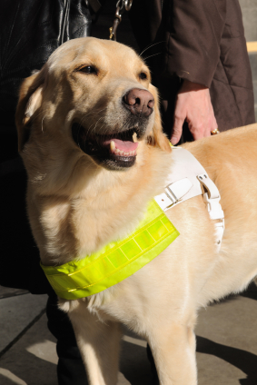
False.
As with any customer, you should offer assistance and wait to hear if or what you can do to assist.
Notes:
If a customer arrives with a walking stick or guide dog, I should offer to go and get the product for them.
False. This goes against the core principle of independence. As with any customer, you should offer assistance and wait to hear if or what you can do to assist.

Slide 41
Taking Appropriate Actions
Service Animals
Support Persons
Assistive Devices
Notes:
As stated earlier, customers may arrive at our business with service animals, support persons or assistive devices. It is important to understand how to take appropriate actions when these situations arise.

Slide 42

Service Animals
Notes:
A customer may arrive with a service animal. In the majority of cases this will be a dog; however, there have been cases of service animals that are monkeys, parrots and other animals that offer critical assistance to persons with disabilities.

Slide 43
How Service Animals Provide Assistance
Service animals offer a variety of types of assistance including:
Autism assistance
Guiding owner
Psychiatric services
Hearing by alerting the owner to sounds
Mobility by pulling wheelchairs, carrying objects, etc.
Seizure assistance
Notes:
Service animals offer a variety of types of assistance including:
Autism assistance to prevent a child from running into danger and responding when sensory stimulus is heightened;
Guiding by following the directions of owner, alerting owner of changes in elevation and of obstacles;
Psychiatric services by retrieving and prompting person to take medicine, activating medical alert and leading the person out of crowds;
Hearing by alerting the owner to sounds, leading them to the source of the sound and by using a special signal to alert the owner of fire alarms or emergency situations;
Mobility by pulling wheelchairs, carrying objects, turning handles, activating push buttons and providing balance; and/or
Seizure assistance by steering the owner away from danger during a seizure, activating medical alert and notifying the owner of an oncoming seizure.

Slide 44
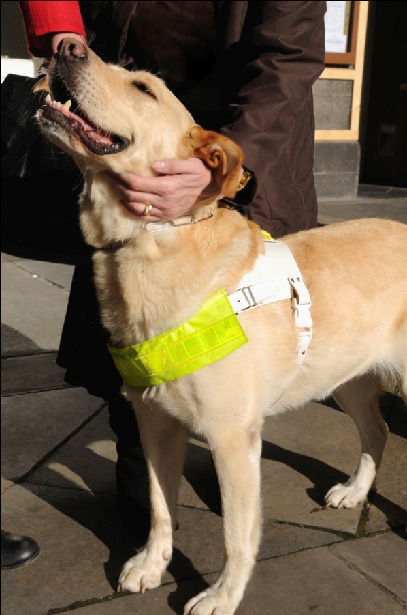
Rules for Handling Service Animals
Never separate the customer and their service animal
Don't touch, pet or talk to the animal
Do not feed or offer treats to the animal
Notes:
Rules for Handling Service Animals would include:
Never separate the customer and their service animal
Don't touch, pet or talk to the animal – when the animal is out with the customer, it is working and should not be distracted
Do not feed or offer treats to the animal
Over the next few slides, we will review some common questions about service animals and recommended actions to take in each situation.

Slide 45

What if I cannot clearly identify that the animal is a service animal?
Identifying a Service Animal
Notes:
What if I cannot clearly identify that the animal is a service animal? For example, no special harness.
A: If you are not sure if the animal is in fact a service animal, ask the customer. Verification may include:
- A letter from a physician or nurse confirming that the person requires the animal for reasons related to the disability;
- A valid identification card signed by the Attorney General of Canada; or
- A certificate of training from a recognized guide dog or service animal training school.

Slide 46

What if the animal becomes disruptive or out of control?
It is the owner’s responsibility to maintain control.
Suggest a quiet place for the owner to sit and calm the animal
Do not touch the animal
Notes:
What if the animal becomes disruptive or out of control?
A: It is the owner's responsibility to maintain control. If the animal is becoming disruptive ask the customer if you can do anything to assist them in regaining control – for example, offering them a private location to calm the animal. Remember that you should never touch the animal or have to clean up after it.

Slide 47

Areas service animal should not be permitted
Service animals are not permitted in locations where food is manufactured, prepared or processed.
Notes:
Are there locations or areas that the service animal should not be permitted?
A: The Health Protection and Promotion Act provides strict guidelines around animals and food. However, service animals, because of the nature of their work, are permitted in locations where food is served, sold and offered for sale. They still are not permitted in locations where food is manufactured, prepared or processed.

Slide 48

What if another customer is severely allergic to the animal?
Consider talking to both customers to determine if they can be in separate areas of your business, while still receiving the same service and access.
Notes:
What if another customer is severely allergic to the animal?
A: It is your duty to accommodate both customers. You would need to devise an accommodation plan that will work for both individuals. Consider talking to both of them to determine if they can be in separate areas while still receiving the same service and access.

Slide 49

Support Persons
Some customers may require the assistance of a support person.
Notes:
Some customers may require the assistance of a support person. A support person is an individual hired or chosen to accompany a person with a disability to provide service or assistance with communication, mobility, personal care, medical needs or to access services. Personal care needs may include, but are not limited to, assistance with eating or using the washroom. Medical needs might include: ensuring medication is taken on time, monitoring someone's health conditions and providing injections. A support person can be a paid worker, volunteer, family member or friend and does not necessarily require any special training or certification to offer support.

Slide 50
General Tips for Working with a Support Person
Introduce yourself to both persons
Talk directly to the customer
Address the customer appropriately
Don't try to have side conversations with the support person
Provide any written materials to both persons
Never separate the customer and their support person
Notes:
General tips for working with a support person:
Introduce yourself to both the customer and support person
Talk directly to the client, even if the support person is responding
Address the customer appropriately such as asking: "How can I help you today" as opposed to asking the support person "Can you find out what they need?“
Don't try to have side conversations with the support person
Provide any written materials to both the customer and support person
Never separate the customer and their support person

Slide 51
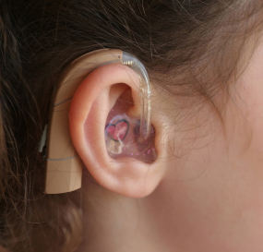


Assistive Devices
Notes:
Some customers might also need assistive devices to assist them in accessing our goods or services. Assistive devices can enable them to do everyday tasks such as moving, communicating, reading or lifting. Here are a few examples of devices that could be used: white canes, wheelchairs, walkers, listening devices, hearing aids, magnification devices, portable oxygen tanks, laptops with screen-reading software and communication programs, communication boards, smart phones and speech generating devices.

Slide 52
General Tips for Working with Assistive Devices
Never refuse to work with the device
Don't stare or gawk at the device
Ensure the customer and assistive device have the appropriate amount of space
Don't block, knock or bump into assistive devices
Offer assistance if the customer is having trouble working with their device
Notes:
General tips for working with assistive devices:
Never refuse to work with the device
Don't stare or gawk at the device
Ensure the customer and assistive device have the appropriate amount of space
Don't block, knock or bump into assistive devices
Offer assistance if the customer is having trouble working with their device

Slide 53
Service Disruptions
Out of Service
Being disabled should not mean being disqualified from having access to every aspect of life.
-- Emma Thompson
Notes:
Service disruptions happen for many reasons and can cause serious upset, hardship and disappointment to all of your customers. Responding and handling service disruptions in a way that supports and informs customers is important for maintaining solid relationships and offering great service. Service disruptions can include: broken elevator, cancelled programs, unplanned closures, construction barriers, sick employees and inaccessible parking. Disruptions should be communicated, immediately and in a variety of methods. You should indicate when the service will be restored and suggest alternatives to be used during the disruption.

Slide 54

Best Practice Tips:
Notifying of Disruption in Service
Post notices throughout
the building
Email notification to regular customers
Phone customers with scheduled appointments
Notes:
Tips for notifying of disruption in service:
• Posting at the main entrances and the source of the disruption
• Phone and/or email a notification to regular customers or customers with scheduled appointments
• Include the service disruption on the company's website

Slide 55

What should I do if the elevator stops working or another service disruption happens while I am working?
Responding to Service Disruptions
Notes:
What should I do if the elevator stops working or another service disruption happens while I am working?
A: Any service disruption should take top priority. Ensure that no one is trapped or stuck because of the disruption. Notify the proper person, companies and potential clients of the disruption. Post visible and easy to read signs at all entrances and at the disruption site that notifies visitors of the issue.

Slide 56

Customer Feedback
Notes:
The final piece of the customer service standard is accepting and responding to customer feedback. After all, customer comments can lead to improved service, increased clientele and a reduction in complaints. Establishing a variety of methods to offer feedback such as in person, by phone or through email will mean that all customers will have the opportunity to supply their input into the organization. All feedback should be forwarded to (insert process).

Slide 57

Summary
Treat all customers and others in a polite, professional and respectful manner
Recognize and remove barriers
Notify customers of service disruptions
Collect and address customer feedback
Notes:
Customize to company mandate. By constantly applying the requirements under the AODA and the customer service standards we are furthering our commitment by ensuring that our doors are open to all people and that each customer is treated with dignity, independence, integration and equal opportunity. Together we will make a better Ontario!

Slide 58

Wrap Up
Questions and Answers
Thank you
Notes:
We have reached the end of our training and covered a lot of information in this course. I hope you have enjoyed our presentation and feel comfortable with the policies and procedures implemented at (Company Name) to promote exceptional service to all of our customers. Please test your knowledge by completing the quiz on the following slides.
Thank you again for taking the time to participate in this training!

